Slide 1
Data: Truth and Lies
Heath Henwood
Heath.Henwood@bigpond.com
Ph 0417 730 904

Slide 2
About: Heath Henwood
Twenty Year in Education, working in Schools
5 years as Principal
Last 7 years as a Teaching – Master Teacher, Pedagogical & Curriculum Coach
Qualifications in Leadership; Education; Science; Technology
Worked in:
State and Private Schools
Low & High Socio-economic Schools,
City Regional & Rural
Primary, P-12 Colleges, Secondary & Special Schools

Slide 3
Today’s Presentation address
Why Data?
What Data should we collect?
Model to Become a Data Driven School
How to Analyse Data
Using Data to Inform Teacher Practice
Notes:
50 minutes

Slide 4
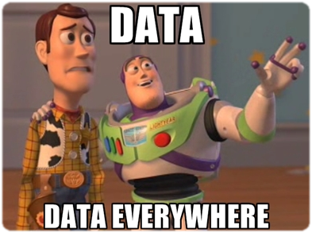
Notes:
Western World – Data on the increase
Credit Card, Fly Buys cards are all collecting data on your buying habits
Google - Flights booked to come to conference – Hotels, Car rentals, attractions adverts started appearing on computer

Slide 5
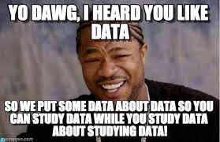
93% of Teachers are Collecting and/or using Data
67% are unhappy with quality & quantity being collected

Slide 6
Notes:
Data is more than just getting and recording the right answer

Slide 7
Why Data?
1. Discover Patterns in Student behaviours & Learning.
2. Discover Patterns in Teacher behaviours, Learning & Teaching.
3. Improve Curriculum
4. Guides Conversations
5. Promotes a Culture of Learning within the School
Notes:
Student = Models = detailed information such as students’ knowledge, motivation, metacognition, and attitudes;
Student = showed that deficits existed in the learning of many students.
Student = To predicting students’ future learning behaviour by creating models that detail students’ characteristics
2. Teacher = Identifies Teacher needs for Professional Learning
3. Curriculum = Identifies what curriculum needs to change
4. Guides Professional Conversations
5. Promotes a culture of learning

Slide 8
What Data?
What Data will be useful for your School?
For Your Teachers?
Data is to guide Conversations – What Data is required to direct conversation about:
Academic Learning?
Behaviours?
Communication?
Notes:
Data by itself is useless. Need the conversations

Slide 9
What Data?
Formative Assessment
Standardise Tests
Observations
Projects, Essays & Exams
Formal Reports eg Medical,
Notes:
Formative Assessments: Low-stakes assessments are really the most important and useful student data.
Observations: allows you to gather data on individual students: How well are they making sense of the content? Interacting with others? Are they struggling with a learning activity? Such data from observations then leads us to adjust pacing for the whole class or scaffold for those students who are still struggling.
Projects, Essays, and Exams: Summative assessments, such as literary analysis essays or end-of-unit science exams, allow us to measure the growth of individual and whole-group learning. If a large number of students don’t do well on a high-stakes assessment, we need to reflect back on the teaching and make necessary adjustments in the future.

Slide 10
Becoming a Data Driven School
Data gives the what,
It does not gives the why
or how
Notes:
(Why did they not get it?)
(how we reteach the skills in a learnable way?)

Slide 11
Becoming a Data Driven School
Professional Development
Notes:
Invest in staff
Big Picture – let Teachers see their own professional development process,
Case Studies
Learn the process
use the professional development materials from Driven by Data.
To make data wall conversations and case management discussions part of teachers’ work means prioritising professional leaning in new ways. Effective cultural change takes time and acceptance, in real terms, and ‘any action that improves teachers’ effectiveness at promoting student learning is professional development’ (Cole, 2004, p. 5). For our teachers, recognition of the time given to this work is counted as professional development, contributing to the Queensland College of Teachers’ requirement for all Queensland teachers to engage in professional development.

Slide 12
Notes:
Model – Becoming a Data Driven School

Slide 13
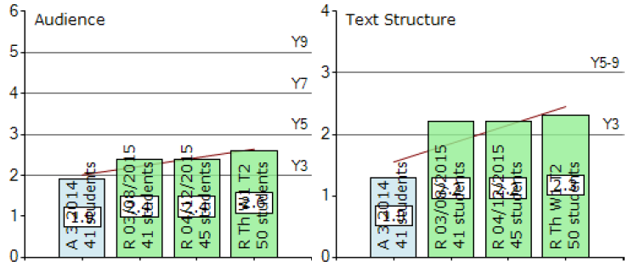
Becoming a Data Driven School
Notes:
(Why did they not get it?)
(how we reteach the skills in a learnable way?)

Slide 14
Professional Development
Start Small
Notes:
Determine Essential Standards
Start Small – not possible to fully implement everything, everyone at once.
focus our assessments - Determine our essentials. Ask:
What are the standards that students must master in order to move on to the next level of the subject eg Fountas & Pinnel, Torch Test, PM Reader
Which standards will be assessed, and then retaught if not yet mastered?
Avoids pitfall of covering too many standards without ever going deep enough for mastery.

Slide 15
Professional Development
Start Small
Teach & Assess
Notes:
Create High-Quality Interim Assessments
High-quality assessments are a prerequisite for getting high-quality data.
To get longevity in data you need to have continual data set with the same data – produces assessment rigor
creating high-quality questions that pinpointed what students knew and didn't know.
Schools are being bombarded with data collection.
The process of review is inclusive of all members of the school community, with questions asked of all stakeholders including students, parents and cleaners.
The review process is a supportive process designed to assist school leaders in making decisions about change that will lead to improvement.

Slide 16
Professional Development
Start Small
Teach & Assess
Data Systems
Notes:
Develop a System for Creating Data Reports
Need an effective data base to collect, store, analsyis data and produce reports.
Reports need to be detailed.
Eg. learning management system (Blackboard)
MS Excel, Access
Needs to allow data can be exported.
Schools often overlook this step, collect and store large amounts of data, but it is in a form that can not be effectively used for analysis or exporting. Process is tricky and time consuming, so significant planning and resources must be devoted to getting it right.

Slide 17
Professional Development
Start Small
Teach & Assess
Data Systems
Data Analysis
Notes:
Create a Process for Data Analysis
Schools need to invest in this process.
It takes time to analyse the data, and results by student, question, and standard. - and for the meetings to discuss observations, is essential.
Cancel faculty / staff meetings to allow teachers time for preparing their analysis.
Pairs or groups of three of teachers & administrators for a 30-minute data-analysis meeting, held during teacher prep time either during the day or after classes. This provides an opportunity for rich discussion of what the data shows -- and what needs to be done next.
Embed professional development in the process, as colleagues brainstorm instructional strategies that might be used for reteaching standards that were not yet mastered.

Slide 18
Professional Development
Start Small
Teach & Assess
Data Systems
Data Analysis
Reteach
Notes:
Follow Up on Reteaching
Follow up with your teachers on their reteaching. During collaborative teacher meetings and meetings with administrators, ask each other:
How did it work?
Will you use that approach from the outset next time?
What do your students still not get?

Slide 19
Professional Development
Start Small
Teach & Assess
Data Systems
Data Analysis
Reteach
Notes:
Invest in the program
Share what is happening, class improvements with whole staff – ensures Buy-in from teachers reluctant to start process
Provide teachers with time to:
Analysis Data
PD on process
Data Conversations
Review practices and processes
Share with other staff

Slide 20
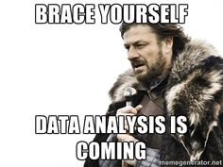

Slide 21
Analysing Data
Notes:
GRAPH – READING AGE – IMPROVEMENT YEAR – NO IMPROVEMENT – IMPROVEMENT.
WHAT IS STORY OF THIS YEAR? – Illness, poor teacher, family breakup,

Slide 22
Analysing Data
Notes:
WHAT IS STORY OF THIS YEAR? – Does this reflect on the teacher, the environment, the lack of support, what was going on in a class that year.

Slide 23
Analysing Data
Notes:
WHAT IS STORY OF THIS YEAR? – Does this reflect on the teacher, the environment, the lack of support, what was going on in a class that year.
Teacher in year 3 – over inflated grades

Slide 24
Analysing Data
Notes:
WHAT IS STORY OF THIS Student? – More often we see a graph like this, where the student had rapid growth early and minimal growth later. Why Engagement, School Environment, Home Environment, Cross from Primary to Secondary,

Slide 25
Analysing Data
Ask what is the Story Behind the Data
Putting Faces on the Data
Importance of teachers knowing students well.
Notes:
Lyn Sharratt – PD on Putting Data on Faces Sharratt & Fullan - Book
Using all the Data to build a picture about the student across the school. Different facilities working together for a child.
Teachers work with data to build knowledge of students and their learning.

Slide 26
Analysing Data
Not a Solo Journey
Collaboration provides a space for professional learning.
Notes:
Not Solo – no individual heroes – breaking culture of teaching being an individual
Suggest teachers meet twice each term to analyse progress & select strategies.
Share student work samples. source of robust discussion, revealing much about not only the students, but also the teachers
Encourages staff to seek advice and share information that ultimately will benefit students and increase teacher satisfaction.

Slide 27
Analysing Data
Conversation should addressed:
Background information
Areas of need for the student;
Basis for student under-performing / current performance
Identify one area of improvement
Plan SMART goals for this student
Strategies that you will implement
Date for the next meeting.
Notes:
background information – School, Home, Social, Strengths, Disabilities, Learning Style, Level the student is working at
the areas of need for the student;
Basis for student under-performing. the root causes (engagement, learning skills, academic) for the student not achieving at a higher level;
Identify one area of improvement – One thing, not everything to help student to improve academic outcomes.
what we (the teachers) would do to improve achievement (countermeasures).
SMART Goal – Specific, Measureable, Achieveable, Reaslistic, Timely - a plan: a reasonable short-term goal for this student and why that was important;
the date for the next meeting.

Slide 28
Professional Development
Start Small
Teach & Assess
Data Systems
Data Analysis
Reteach
Notes:
Comes back to the model
Conversation – PD, Picking one element to develop, Strategies to teach and assess, analyse that assessment – did it work, reteach, what as a teacher do I need to learn to teach better (conversation); where to next. Cycle continues
Case management conversations, provide teachers with an effective form of in-house professional learning.
They situate formative assessment practices and the analysis of student work as valuable modes of understanding how students learn. We identify the strengths of this approach and discuss issues that arose and adjustments that were made as the school undertook the journey to improve student data

Slide 29
Using Data to Inform Teacher Practice
Conversations are ongoing
Teachers are continually getting new data to examine & make changes.
Once we notice something in the data, we have the initiate conversations.
Notes:
Once the students are benchmarked and that data is shared, the conversation about those scores doesn't end.
Teachers are talking data all the time.
Share the data - meet as a group to look at the numbers and talk about what to do with it, how it applied to research-based practices, and strategize collaboratively as a school.
Regular peer meetings to review their data together and strategize, as well as sharing tips and practices.
Data Walls need to renewed on an ongoing basis to include new data from summative assessment. New information allows for continuing discussions of student progress to occur.

Slide 30
Analysing Data
Professional conversations – Time Issues
Addressed in:
Staff Meetings
Professional Development, twilight sessions,
Through Head of Department.
Notes:
Grattan Institute (Goss, Hunter, Romanes, & Parsonage, 2015) argued that: Schools should develop a plan to collect robust evidence of student learning (what each student is ready to learn next, and how much her learning has progressed) and use this data to target teaching and track student progress over time. (p. 40)

Slide 31
Using Data to Inform Teacher Practice
Utilise Data Walls to provide a visual displays and case management meetings around selected students.
Making It Collaborative, Not Competitive
Teachers see everyone’s data, not just their own data and scores.
Creates a culture of openness
Notes:
Teachers may feel that they will be judged by their students' data, and it was something they kept to themselves.
However it is an opportunity for staff to collaborate and strategize together.
Everyone's data is shared and projected on screen after the benchmark assessments, and teachers come together to draw strengths from each other as they reflect on the data.

Slide 32
Becoming a Data Driven School
Notes:
(Why did they not get it?)
(how we reteach the skills in a learnable way?)

Slide 34
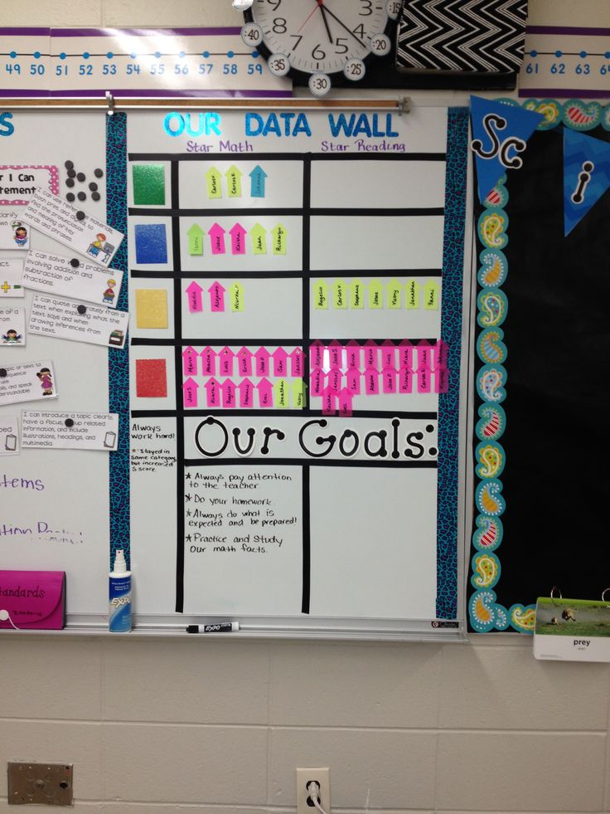
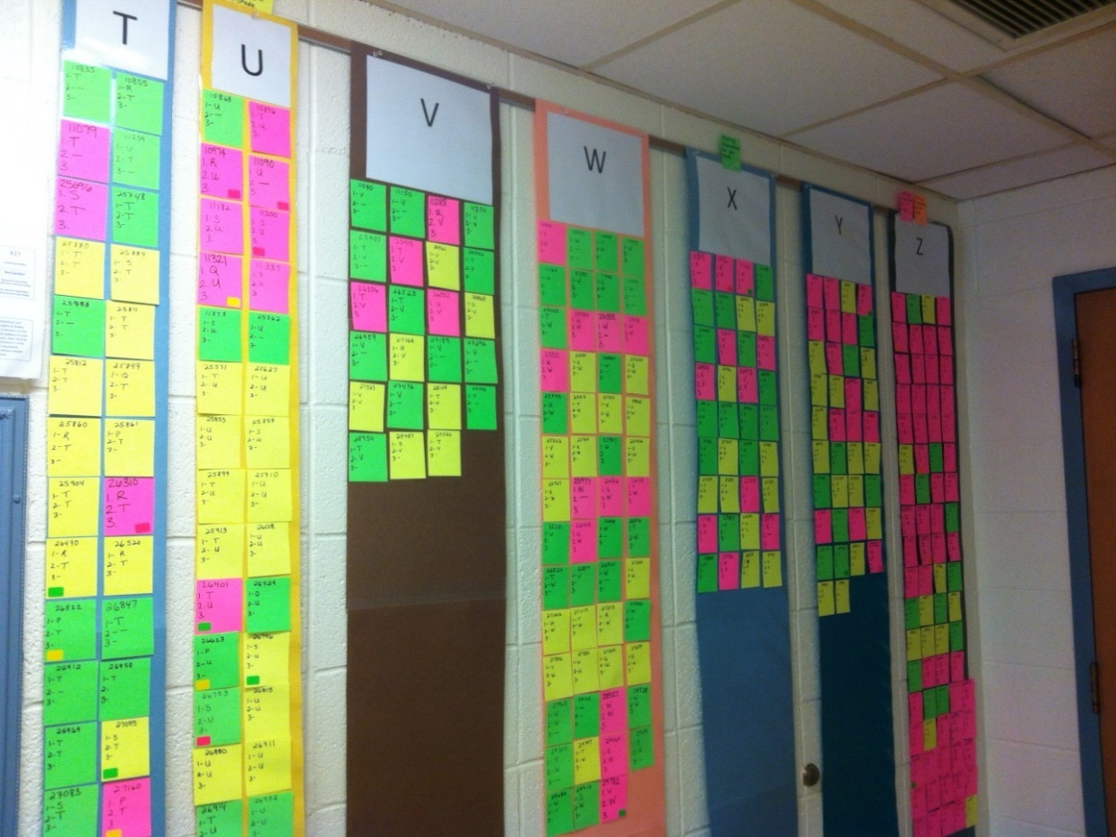
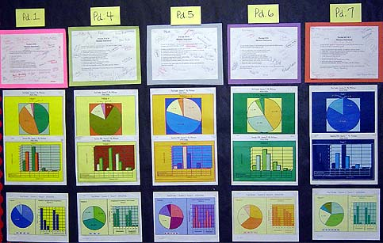
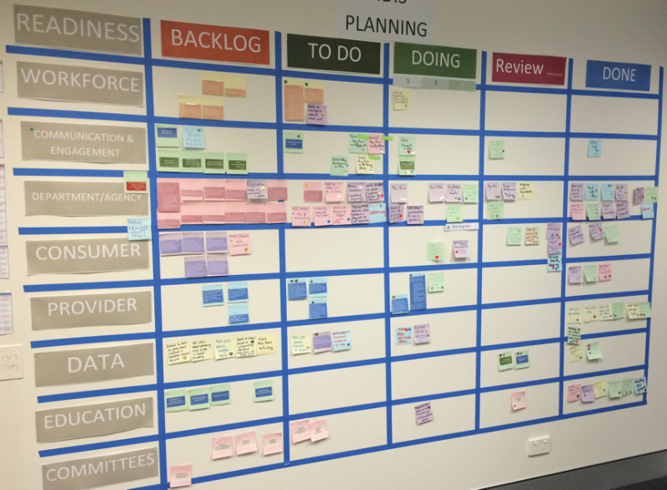
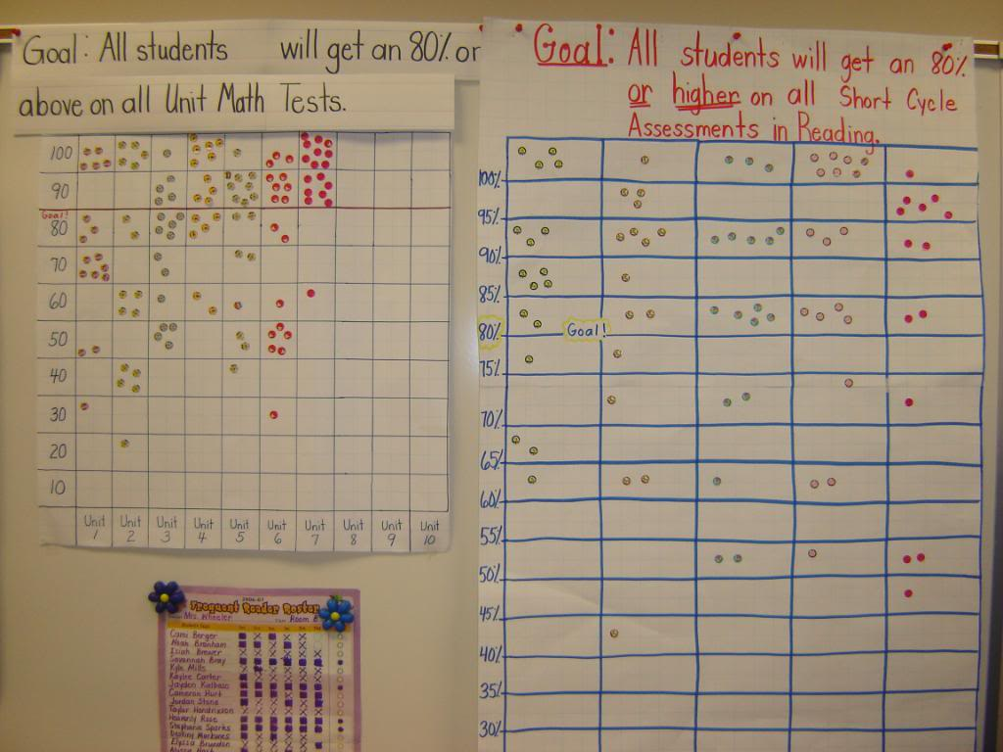
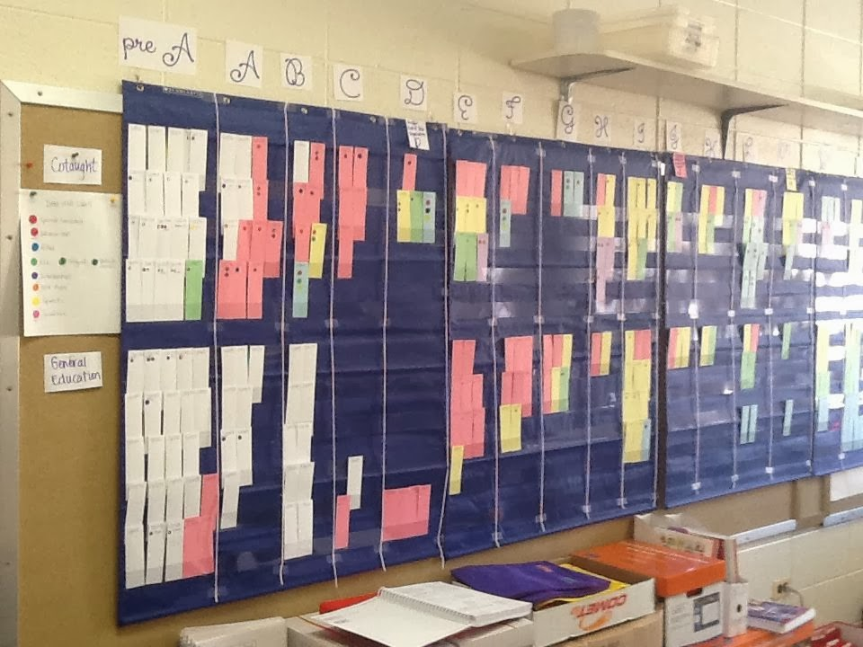
Data Walls
Notes:
Share where schools sits with whole staff – develops a picture of where the school is. Don’t allow the excuses – every child can improve performance if staff are willing to act
began aggregating all kinds of data, pushing it out to the teachers and staff, and exploring the role it could play in helping the school turn the tables on its under-performing label.
Creating the space for this kind of work is a challenge facing school leaders, as it is asking more of teachers in the limited time they have available.

Slide 35
Data Walls
Notes:
Different Classes data shared together
Notes – written on

Slide 36
Data Walls
Notes:
Linking Students in Maths and Reading with Goals

Slide 37
Data Walls
Notes:
Part of the whole school reading benchmarks.
Notes – record assessment results & dates, and a log on where moving.

Slide 38
Data Walls
Notes:
Data Walls can be much more than academic results – whole school operations

Slide 39
Data Walls
Location - Where teachers have regular access
Students should have access to their own data.
Notes:
Data Walls increases the likelihood of engaging staff in discussions about student data.
Students should have access to their own data, but not see the data of other students.
Share Testing Results With Students Individually: After doing this, set some obtainable, realistic goals for each of them to work toward before the next test.

Slide 40
Using Data to Inform Teacher Practice
Develop a school Data-Friendly Culture
“Death by Data“
Determine what would be the most useful for teachers
Every teacher will have a different comfort level of working with data.
Notes:
Work out how to use the data, how to share it, and how to get everyone on the same page with the numbers.
“Death by Data," where teachers were given a mountain of numbers and often felt a sense of "now what?"
Determine what would be the most useful for teachers, providing them with enough data to help them feel effective and targeted in their instruction without crossing the line into overwhelming.
Recognise that every teacher will have a different comfort level of working with data, but once they looked at the data and were able to see the data points start to move for their students, the staff developed an overall sense of empowerment and buy-in.

Slide 41
Using Data to Inform Teacher Practice
Student Driven Data
Have Students rate the content and the teaching
In the past Teachers have "Taught to the middle."
We need to Teach individuals, corporately
Notes:
Give them scaled statements (1-10) to rate how well they understand the material, and let them give you some feedback on your teaching (too fast, too slow, more time to work with peers, more one-on-one time with the teacher). These data are easy and quick to collect. Keep it anonymous so that students are more truthful.
For example, at the conclusion of the cyberbullying unit, perhaps include a question like the following:
On a scale from 1-10, (10 = really confident; 5 = pretty confident; and 1 = not confident at all) how would you rate yourself if you had to teach a group of your peers about cyberbullying?
These data can tell you a lot and help you decide what to plan -- and what supports to use -- for the lessons to follow.
aim to build teacher knowledge of students and their learning.
challenging to diagnose your students as learners.
How do you discover individual reading and writing levels?
How do you determine where each child is developmentally with reasoning, or with collaborating?
how do you pinpoint patterns of strength and weakness within the classroom
Takes understanding of what the median skill level is for a group of 14-year-olds (reading, writing, speaking, thinking, emotional, etc.)
There's a saying: "Teach to the middle." But what if you don't know what that looks like yet? - WRONG – Teach individuals, corporately

Slide 42
Using Data to Inform Teacher Practice
Use the Data to Decide Student Grouping and Differentiation
Get Curious About Contradictions and Take Action
Notes:
Standardized test data reveals how your students performed: advanced, proficient, basic, and below basic. This could help inform how you choose student groups, create seating charts, and differentiate for individuals.
For example, if I have a student who has historically scored below basic and exhibits other signs of a struggling student, I like to place her in the front of the class so that I can easily access her when she needs extra support. If you have a large number of students who scored advanced in your third period class, and a large number of students who scored basic in period two, this may give insight into why period three is moving more quickly and more deeply through content. You can adjust the learning and support accordingly.
How about that ace student who didn’t do so well on the standardized test? Possibly a nervous test-taker? Or it could simply be low motivation, since many students never hear about their standardized test results from previous years? Prior to a test, a brief pep talk or quick review of strategies for lowering test anxiety could be all they need. Also, there is much information to be gained from having individual conversations with students who have these contradictions between their standardized test scores and their classroom grades and performance.

Slide 43
Questions?
Heath Henwood
Heath.Henwood@bigpond.com
Ph 0417 730 904

Slide 47
Notes:
Data presentation – Data walls and Graphing

Slide 48
Data Collection Tools
Range to choose from with a variety of methods for representing data
Utilised Microsoft Excel to create proformas for representing the data
Notes:
Microsoft Excel offers extra capabilities for table creation and formatting. Excel also enabled all data sheets for one year level to be saved as a workbook and printed as a single document

