Slide 1
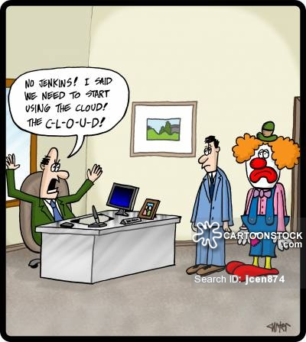
Overcoming Barriers in Adopting Technology
Heath Henwood
Heath.Henwood@bigpond.com
Ph 0417 730 904

Slide 2
About: Heath Henwood
Twenty Year in Education, working in Schools
5 years as Principal
Last 7 years as a Teaching – Master Teacher, Pedagogical & Curriculum Coach
Qualifications in Leadership; Education; Science; Technology
Worked in:
State and Private Schools
Low & High Socio-economic Schools,
City Regional & Rural
Primary, P-12 Colleges, Secondary & Special Schools

Slide 3
Today’s Presentation
Classroom teachers face a range of barriers that prevent them from adopting technology across the classroom.
This session discusses a range of solutions for teachers to overcome:
Common Barrier to Implementing Technology
Practical Strategies to adopting technology
Thoughts for Leaders

Slide 4
Common Barriers – How to Overcome
Money – The lack there of!
Expertise – The lack there of!
Internet – How slow can you go?
Technical Support!
Which Device?
Timing – When do I adopt?

Slide 5
Where can I get $$$$$
Is it a school priority?
Who is driving it at your school?
Grants
Partnerships with business.
Gifts – Clubs
Councils and Government (partnerships)
Notes:
Need a Technology Champion to drive the change and introduction of tech.
Grants – Hardware
Partnership with Microsoft, Apple, Samsung, adobe, Google – Funding and PD
Gives state schools an opportunity to compete with private school budgets

Slide 6
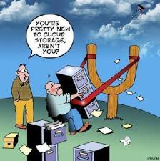
Developing Expertise
Notes:
Developing Expertise

Slide 7
Developing Expertise
What PD do I need?
What PD is available?
Notes:
Teachers need to develop a critical awareness of the range of pedagogical approaches to which m-learning lends itself, and actively balance considerations of pedagogy and content with considerations of technology.
teachers must be ready to engage in self-directed learning as technologies change, their teaching contexts shift, and their students' needs evolve;

Slide 8
Developing Expertise
Change will inevitably produces tensions.
Training must ultimately be about
"helping teachers to help themselves“
Reflect on Learnings
Notes:
Pedagogically grounded and adequately contextualised professional development (PD) was seen as vital for time-poor staff, while a desire to set up a professional community of practice was widely expressed
teachers must be ready to engage in self-directed learning as technologies change, their teaching contexts shift, and their students' needs evolve;

Slide 9
Developing Expertise
Focus on pedagogy ahead of technology in PD.
Invest in time for PD to support the rollout of new technologies.
Explore truly innovative uses of the devices
Targeted and contextualised PD is most effective. In a rapidly changing field with time poor teachers - individualised PD delivered at the point of need is required
Build Professional Learning Network
Notes:
Main recommendations emerged regarding PD.
Staff need time to attend formal PD; engage in informal collaborations with colleagues; play with devices in order to build familiarity; research apps; and explore wider pedagogical possibilities.
MENTORING /COACHINGIn a rapidly changing field, formal PD cannot cover all possibilities. Moreover, for time-poor teachers, standardised PD sessions are likely to be less effective than individualised PD delivered at the point of need, for example, support being provided by a technology co-ordinator or mentor
Professional learning networks for ongoing learning. - sustainable model which encourages collaboration, save time and energy, & avoid schools and teachers reinventing the wheel

Slide 10
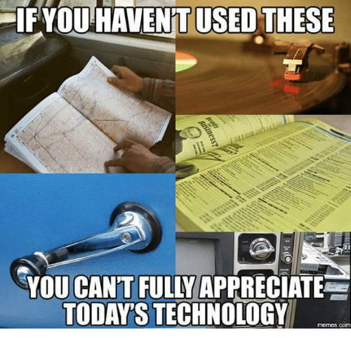
Notes:
Internet Speed and Tech Support

Slide 11
Internet - Speed

Slide 12
Tech Support
BYOD/BYOT model presents challenges of a different kind in terms of the standards and specifications of devices
Network speed and capacity, as well as network security, continue to be important issues
Need to ensure adequate technical support
Notes:
Some devices have been identified as intuitive tools which require less support
a number of students are developing considerable relevant expertise, on which less tech-savvy students and even teachers can draw

Slide 13
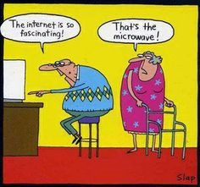
Which Device?

Slide 14
Which Device
All devices have their benefits and drawbacks
Laptops
MacBooks
I-Pads
Mobile Devices / Tablets
Conversation: Consumption v Creation
Notes:
iPad was seen as primarily a consumption tool rather than a productive or creative device
With no models to work from, they had to explore, practice, and discover – on their own – the iPad's potential for expanding learning.
Mobile Devices / Tablets are a game-changer; they encompass many of the tools smartphones offer while presenting an ever-expanding collection of tools for learning.
Certain physical features – such as, for example, small screen sizes on mobile phones – may present some challenges.

Slide 15
Experimenting with mobile handheld devices
Educators are exploring ways to use mobile technologies to enhance teaching and learning
Mobile handheld devices used at all levels from primary to tertiary across KLAs
Australian Research has found that the devices greatly improved communication and opened up space for better teaching models.
Notes:
Experimental Stage

Slide 16
Benefits of m-Learning
Level of motivation and engagement for students
Flexibility in movement and Pedagogy
Mobile technologies have both organisational and pedagogical purposes
Pedagogical uses include apps relevant to areas as diverse as numeracy, science, foreign languages, economics.

Slide 17
Benefits of m-Learning
Schools are beginning to capitalise on the seamless learning spaces opened up by mobile devices.
Use for collaboration or personalisation, and creating seamless learning spaces
Teachers and students have become co-learners and pioneers in the classroom as they test out the power of this new technology.
Notes:
Friction between the single-owner design of iPads and their use in class sets: "we are doing something that is alien to the device ... we have tried to make it behave like a laptop in a trolley when it really should be a student-owned device"
Being so mobile, you are not restricted to being in your classroom or at desks. It was noted that students had more flexibility in when and how to learn, opting, for example, to work on their iPads outside the classroom during lunch breaks, responding to this newfound freedom, was setting up flexible classrooms with no fixed desks in order to foster collaboration and communication between students – a change which some teachers were finding challenging

Slide 18
Drawbacks of m-learning
Issues with mobile handheld devices
New Tech is not designed for education, particularly mobile devices.
Devices need to be repurposed for learning
Friction between the single-owner design of iPads and their use in class sets

Slide 19
Drawbacks of m-learning
Hardware issues - small screen size, Connectivity, Bandwidth, IT Support of devices
Software issues – different apps for difference devices
Content - digital safety and cyberbullying.
Staff issues - "the staff is the biggest blocker”
Notes:
some staff in their institutions were unenthusiastic,
some staff felt overwhelmed and underprepared;
that some were unsure how to integrate mobile devices with their teaching, or did so in pedagogically
limited ways; and, most importantly of all, that all were time-poor, which limited their availability for PD
as well as the time they had to spend researching the most appropriate apps

Slide 20
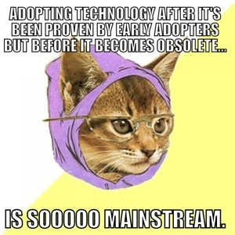
Timing – When Should I adopt Technology?

Slide 21
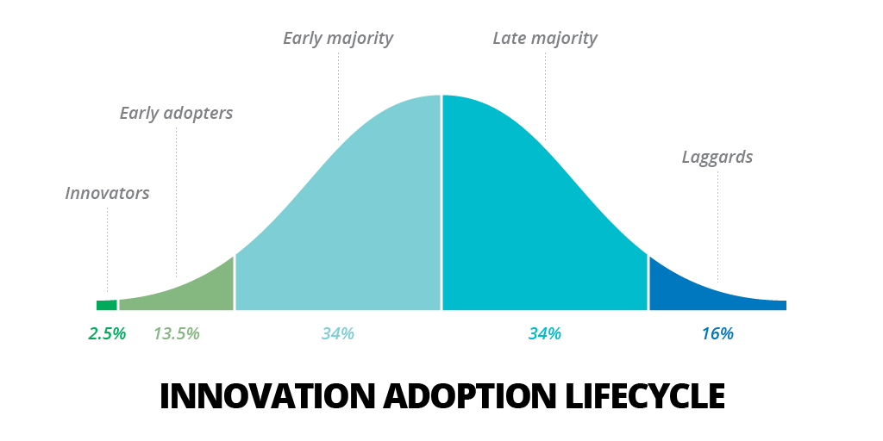

Slide 22
An ecology of learning
The devices themselves are less important than how they are used to support teaching and learning.
These technologies should not be seen as an end in themselves, nor as an add-on to entertain children and keep them busy
Good teaching and teachers have to remain the main drivers

Slide 23
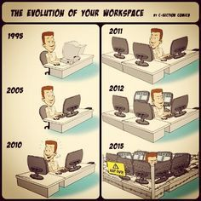
Thoughts for School Leadership

Slide 24
Thoughts for School Leadership
Leadership can provide direction and coordination for an ongoing program that directs student’s learning across KLA’s.
Need to plan know to integrate mobile devices into a broader learning ecology
School leaders are finding the ability to use technology a genuine necessity and benefit in helping them meet their responsibilities.
Notes:
Instead of looking at technology as just another problem on the list of those we face as administrators, we must harness it as a powerful ally. By purposely and continuously improving our administrative technology skills, we can lead with technology, not be led by it.
Six Standards

Slide 25
Thoughts for School Leadership
1. Leadership and Vision.
Create a shared vision of technology by serving on technology planning teams.
Increasingly using curriculum as the driver for technology adoption.
Finding the resources for an ambitious upgrade of school's tech

Slide 26
Thoughts for School Leadership
2. Learning and Teaching.
Supporting teachers to increase integration of technology across KLAs
Student access to technology; wireless connectivity for student-owned laptops and handhelds.

Slide 27
Thoughts for School Leadership
3. Productivity and Professional Practice.
Principal / Key Leader communicates regularly and effectively to staff, parents and community using e-mail, social media and websites, etc.
Reports are illustrated with graphs and photos embedded in multimedia presentations.
Notes:
Principal needs to set the example – recruit help from staff to enable
School Staff Tweets

Slide 28
Thoughts for School Leadership
4. Support, Management and Operations.
Having immediate access to student information –
Systems to track the day-to-day operations, schedules, attendance records, health records, discipline incidents, grades and online teacher gradebooks.
Notes:
Utilise a PDA, synchronized with his desktop computer. He manages his building budget using the district's real-time finance program.

Slide 29
Thoughts for School Leadership
5. Assessment and Evaluation.
Commitment to document continuous improvement through the use of data-mining to:
Evaluate program effectiveness
Identify students needing additional attention
Plan staff development.

Slide 30
Thoughts for School Leadership
6. Social, Legal and Ethical Issues.
Students, always a step ahead of staff in the use of new technologies, find new ways to communicate, learn and sometimes skirt school rules.
An ethical dilemma involves resource allocation--how to balance expenditures on technology with other needs such as class size reduction.

Slide 31
Questions?
Heath Henwood
Heath.Henwood@bigpond.com
Ph 0417 730 904

Slide 32
Other Topics for Discussion
Leadership and Direction.
Integrating technology rather than just implementing or teaching technology
What professional development is required for teachers to ensure that they are proficiency in teaching technology?
How can schools ensure students are progressing with the development of technology, keeping up and surpassing real world developments?
As the use of technology continues to grow, schools need to ensure that they have a comprehensive strategy and vision in education technology.

